Slide 1
Fun Facts GenAI can’t cope
if 2=4, 3=6 then what is 4 equal to?

Slide 2
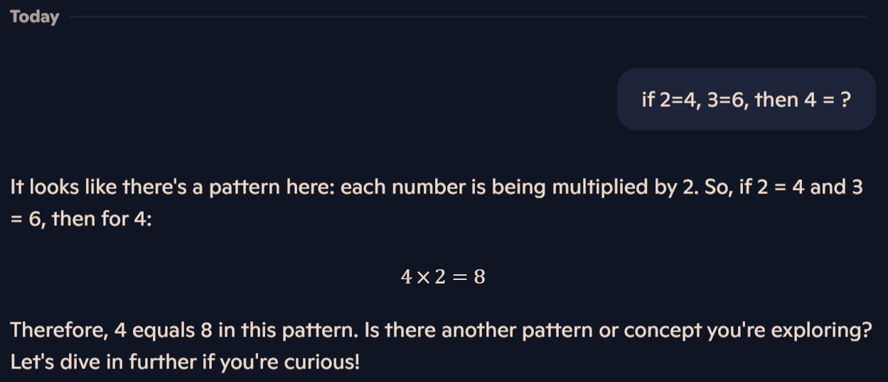
Copilot

Slide 3
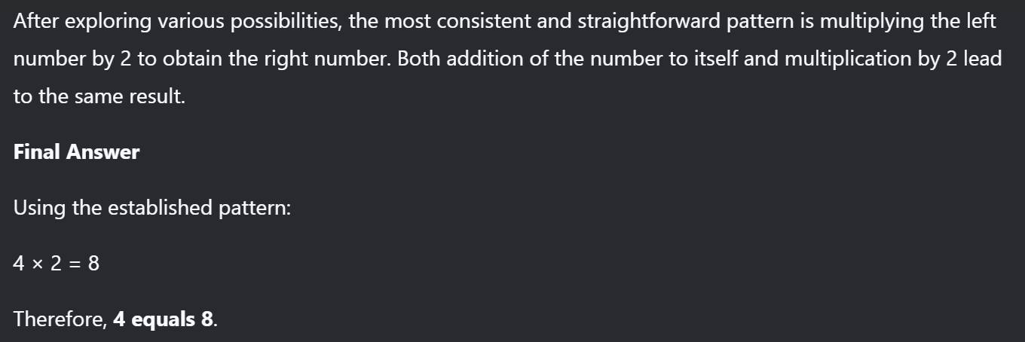
deepseek

Slide 4
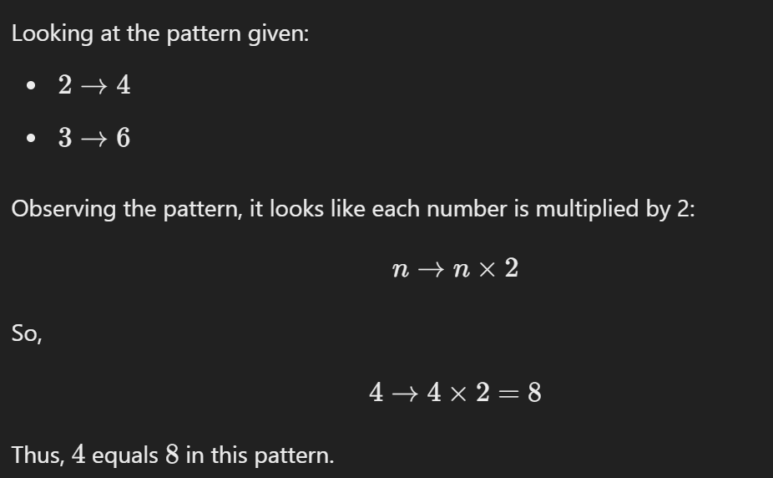
chatgpt

Slide 5




But, the fact is
if 2=4, 3=6 then what is 4 equal to?
You are told 2 = 4, so 4 =2 by simple mathematics definition of = !
This Photo by Unknown Author is licensed under CC BY-SA

Slide 6


Distributed Computing
MSBA AN6007 Advanced Programming
T2 AY2024-25
Coordinator
Mr Koh Choon Chye
cckoh@ntu.edu.sg

Slide 7
Difference between Parallel Computing and Distributed Computing
Parallel Computing and Distributed Computing are two important models of computing that have important roles in today’s high-performance computing. Both are designed to perform a large number of calculations breaking down the processes into several parallel tasks; however, they differ in structure, function, and utilization.
https://wiki.python.org/moin/ParallelProcessing
https://www.geeksforgeeks.org/difference-between-parallel-computing-and-distributed-computing/

Slide 8
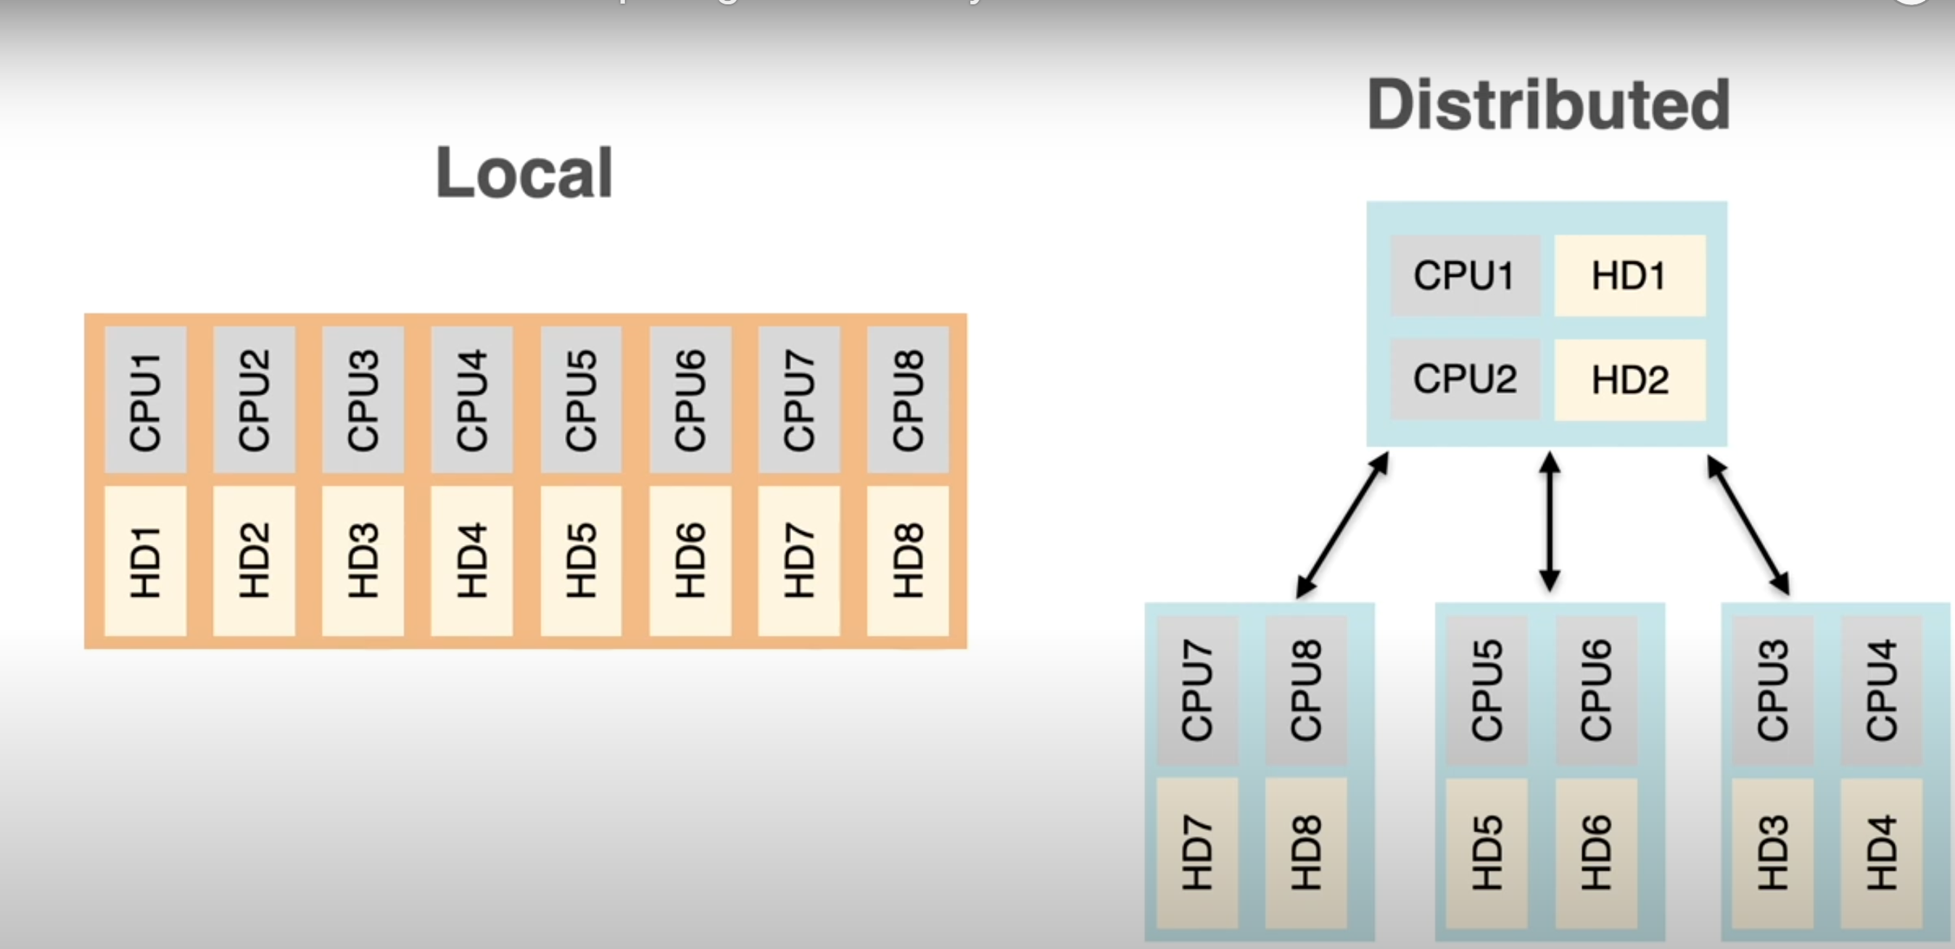
Distributed Computing
In distributed computing we have multiple autonomous computers which seems to the user as single system. In distributed systems there is no shared memory and computers communicate with each other through message passing. In distributed computing a single task is divided among different computers.
Distributed processing involves running tasks across multiple machines, whereas parallel processing generally refers to running tasks on multiple cores within a single machine.
Artificial Intelligence and Machine Learning, Scientific Research and High-Performance Computing, Financial Sectors, Energy and Environment sectors, Internet of Things, Blockchain and Cryptocurrencies are the areas where distributed computing is used.

Slide 9
Advantages of Distributed Computing
Fault Tolerance: The failure of one node means that this node is no longer part of the computations, but that is not fatal for the entire computation since there are other computers participating in the process thereby making the system more reliable.
Cost-Effective: Builds upon existing hardware and has flexibility in utilizing commodity machines instead of the need to have expensive and specific processors for its use.
Scalability: The distributed systems have the ability to scale and expand horizontally through the addition of more machines in the networks and therefore they can take on greater workloads and processes.
Geographic Distribution: Distributed computing makes it possible to execute tasks at different points thereby eliminating latencies.

Slide 10
Disadvantages of Distributed Computing
Complexity in Management: The task of managing a distributed system itself can be made more difficult since it may require dealing with the latency and/or failure of a network as well as issues related to synchronizing the information to be distributed.
Communication Overhead: Inter node communication requirements can actually hinder the package transfer between nodes that are geographically distant and hence the overall performance is greatly compromised.
Security Concerns: In general, distributed systems are less secure as compared to centralized system because distributed systems heavily depend on a network.

Slide 11
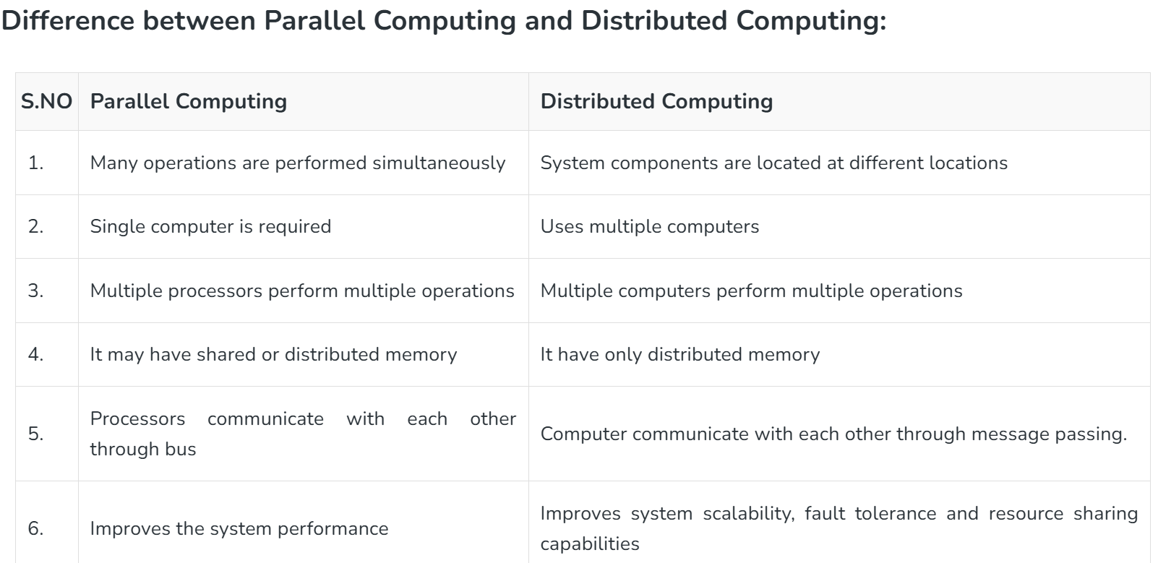
https://www.geeksforgeeks.org/difference-between-parallel-computing-and-distributed-computing/

Slide 12
Most popular frameworks for distributed computing.
Spark
Purpose: General-purpose cluster-computing framework.
Components: Includes Spark Core, Spark SQL, Spark Streaming, and MLlib for machine learning.
Language: Scala (with support for Python, Java, and R).
Use Case: Suitable for batch and real-time data processing, machine learning, and graph processing
Dask
Purpose: Parallel computing library for Python.
Components: Integrates with NumPy, pandas, and scikit-learn.
Language: Python.
Use Case: Great for small to medium-sized datasets and interactive computing
Ray
Purpose: Distributed computing framework for Python.
Components: Supports task scheduling, distributed training, and reinforcement learning.
Language: Python.
Use Case: Ideal for machine learning, reinforcement learning, and other complex algorithms
https://domino.ai/blog/spark-dask-ray-choosing-the-right-framework

Slide 13
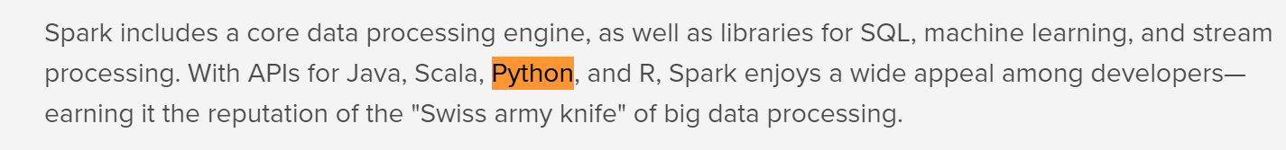
Spark
https://towardsdatascience.com/run-pandas-as-fast-as-spark-f5eefe780c45
https://www.integrate.io/blog/apache-spark-vs-hadoop-mapreduce/
https://www.simplilearn.com/learn-pyspark-free-course-skillup

Slide 14
PySpark
Pyspark is a connection between Apache Spark and Python.
It allows us to work with RDD (Resilient Distributed Dataset) and DataFrames in Python.
PySpark has numerous features that make it such an amazing framework and when it comes to deal with the huge amount of data
PySpark provides us fast and Real-time processing, flexibility, in-memory computation, and various other features.
It is a Python library to use Spark which combines the simplicity of Python language with the efficiency of Spark.
https://intellipaat.com/blog/tutorial/spark-tutorial/pyspark-tutorial/
https://www.tutorialspoint.com/pyspark/index.htm

Slide 15
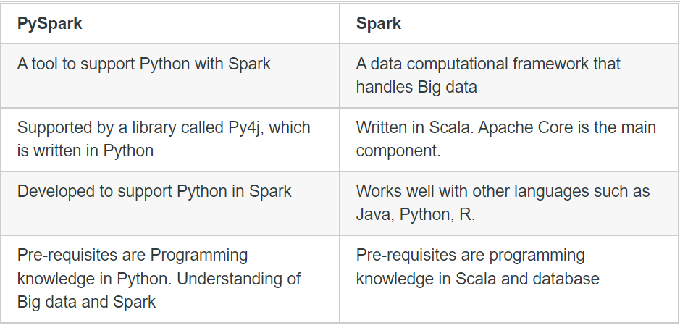
PySpark vs Spark
PySpark Tutorial For Beginners | Python Examples - Spark By {Examples} (sparkbyexamples.com)

Slide 16
Dask
The original purpose of Dask was simply to parallelise NumPy, so that it can take advantage of workstation computers with multiple CPUs and cores.
Dask.distributed is a lightweight library for distributed computing in Python. It extends both the concurrent.futures and dask APIs to moderate sized clusters.
https://training.talkpython.fm/courses/introduction-to-scaling-python-and-pandas-with-dask?form=MG0AV3 2 mins (course)
https://www.youtube.com/watch?v=nnndxbr_Xq4&t=11s 8 mins
https://www.youtube.com/watch?v=Alwgx_1qsj4 16 mins
https://distributed.dask.org/en/latest/
Notes:
Dask.distributed is a lightweight library for distributed computing in Python. It extends both the concurrent.futures and dask APIs to moderate sized clusters.

Slide 17
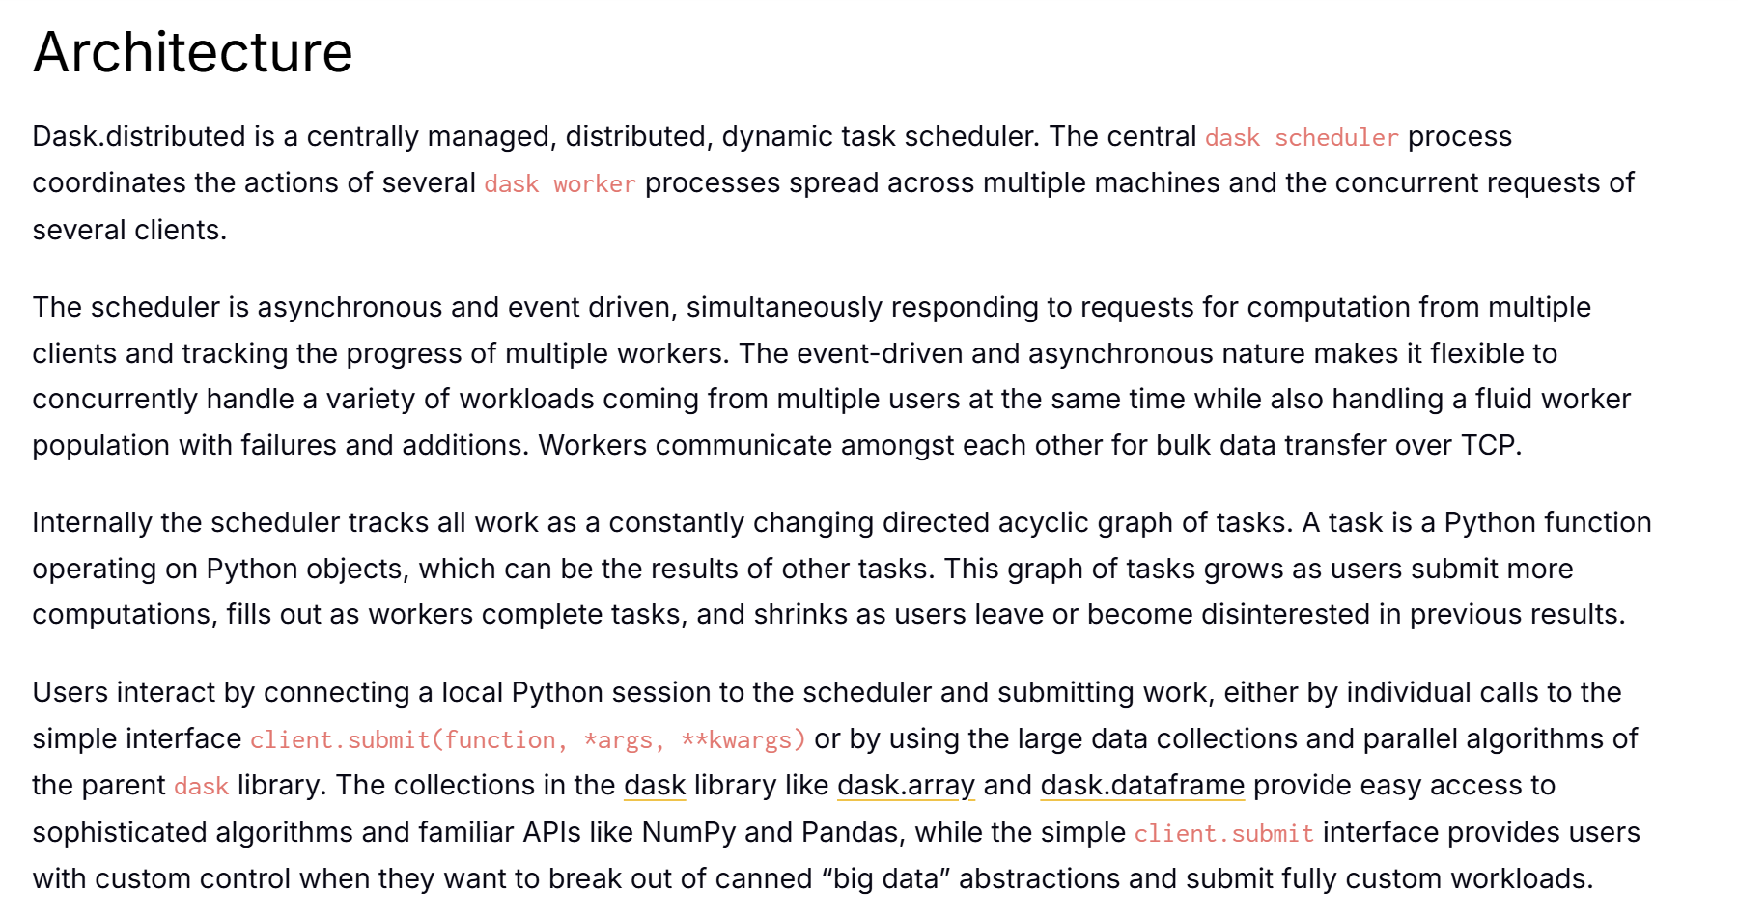
https://distributed.dask.org/en/latest/

Slide 18
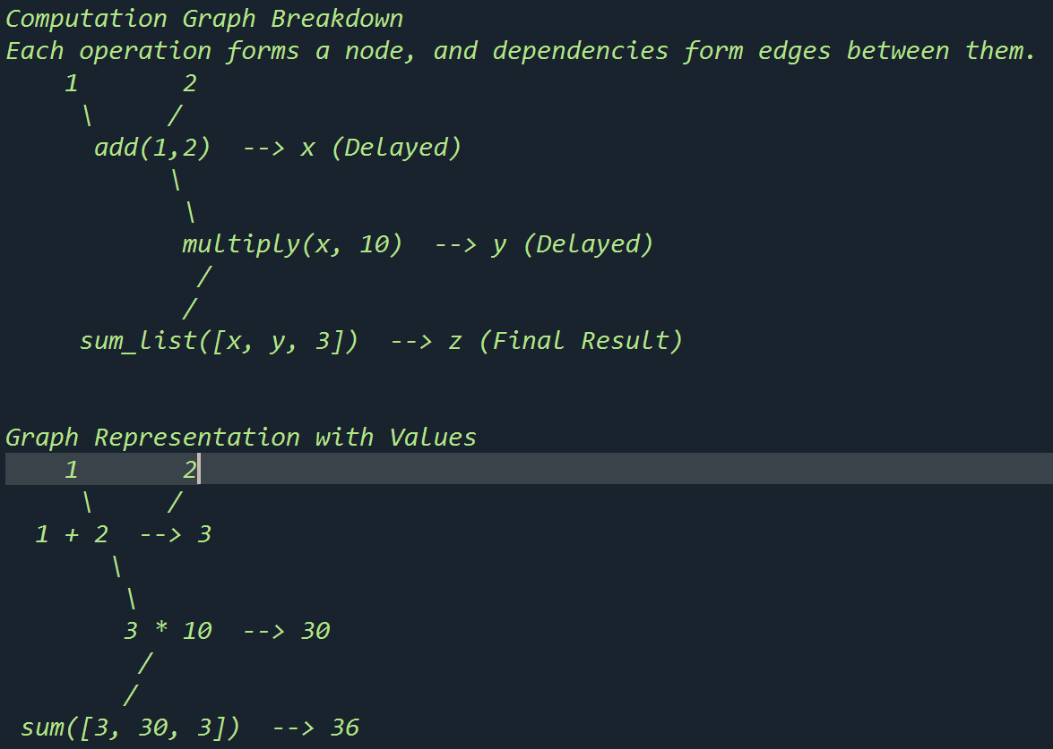
import dask
from dask import delayed
@delayed
def add(x, y):
return x + y
'''
with @delayed
The add function does not execute immediately.
Instead, it creates a delayed object that represents x + y.
Benefits of @delayed:
Parallel execution: Tasks run in parallel when possible.
Optimized scheduling: Dask organizes tasks to minimize computation time.
Handles large data: Useful for computations that don't fit in memory.
'''
@delayed
def multiply(x, y):
return x * y
@delayed
def sum_list(lst):
return sum(lst)
# Create a computation graph
x = add(1, 2)
y = multiply(x, 10)
z = sum_list([x, y, 3])
#These operations do not execute immediately but build a computation graph.
# Compute the result
result = z.compute()
# When .compute() is called, Dask executes all the required computations efficiently,
# following the dependencies in the graph.
print("Result:", result)
dask1.py

Slide 19
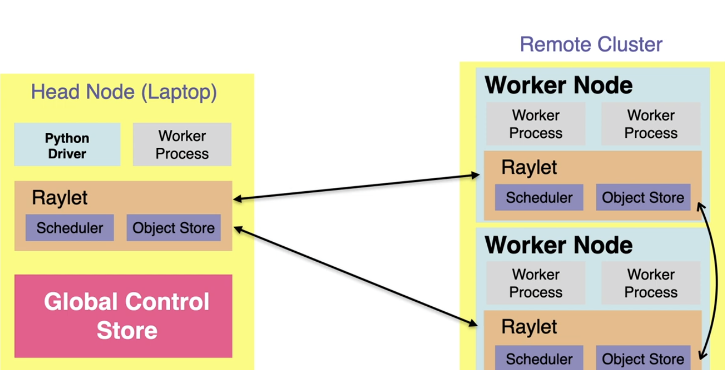
Ray
https://www.kdnuggets.com/2021/08/distributed-python-application-ray.html
https://blog.dominodatalab.com/ray-for-data-science-distributed-python-tasks-at-scale
https://www.projectpro.io/article/python-ray/843
https://www.run.ai/guides/distributed-computing/distributed-computing-with-python

Slide 20
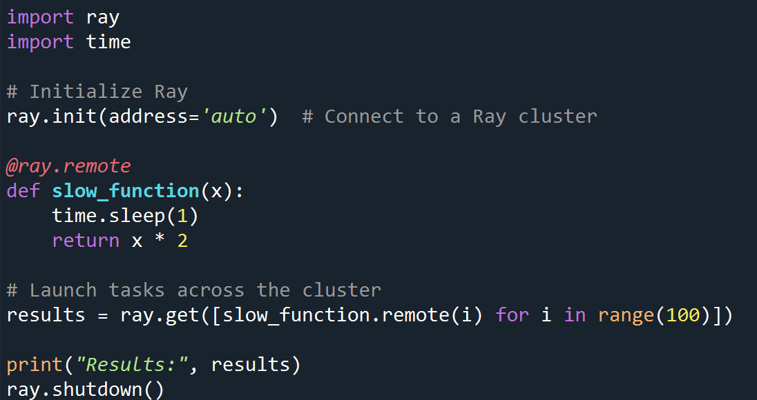
In this example, slow_function tasks are distributed across multiple nodes in the Ray cluster.
https://www.youtube.com/watch?v=q_aTbb7XeL4 10 mins

Slide 21
Ray elearn
https://courses.anyscale.com/courses/intro-to-ray or
https://courses.anyscale.com/order?ct=e5dd5a70-d258-4021-b268-945c3156b737
https://www.youtube.com/watch?v=cEF3ok1mSo0 16 mins

Slide 22

Hadoop is an open-source software framework that is used for storing and processing large amounts of data in a distributed computing environment. It is designed to handle big data and is based on the MapReduce programming model, which allows for the parallel processing of large datasets.
Rather than rely on hardware to deliver high-availability, the library itself is designed to detect and handle failures at the application layer, so delivering a highly-available service on top of a cluster of computers, each of which may be prone to failures

Slide 23
Which framework to use?
If the workloads are data-centric and more around ETL/pre-processing, our best bet would be Spark. Especially if the organization has institutional knowledge of the Spark API.
The Dask/Ray selection is not that clear cut, but the general rule is that Ray is designed to speed up any type of Python code, where Dask is geared towards Data Science-specific workflows.
design your data science process and accompanying infrastructure with flexibility in mind, ideally enabling you to spin up and use the right tool for the job.
A typical pipeline could involve
some ETL-like data processing conducted in Spark,
followed by a machine learning workflow executed in Ray.
A platform that provides the freedom to run both in a controlled, fault-tolerant, and on-demand manner enables the data science team to leverage the benefits of both frameworks.

Slide 24
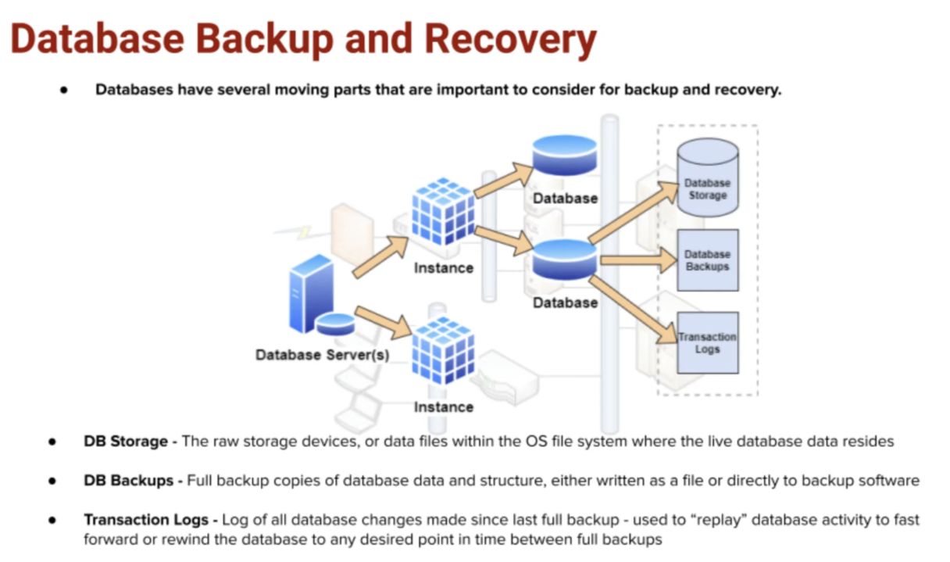
https://www.bing.com/videos/riverview/relatedvideo?q=data+backup+and+recovery+strategies&mid=102AC08A9284B1474A9C102AC08A9284B1474A9C&mcid=DAF81354FC57451FB1DF3F6A24C9F8B5&FORM=VIRE&adlt=strict&toWww=1&redig=9F4943D125504E90B09096B6E2DAA278

Slide 25
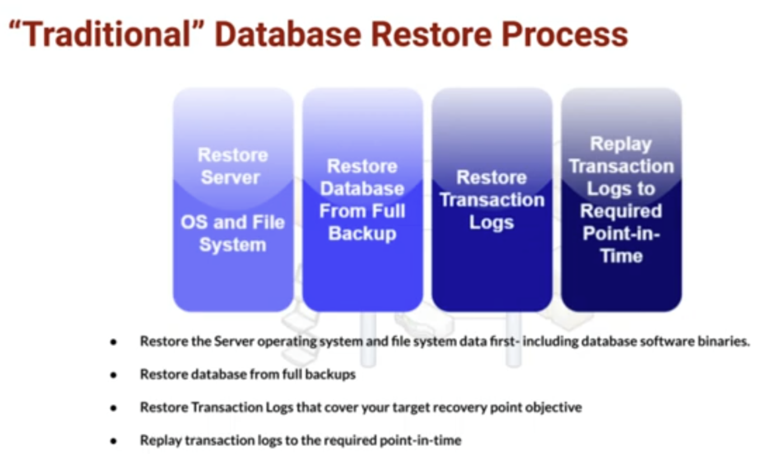

Slide 26
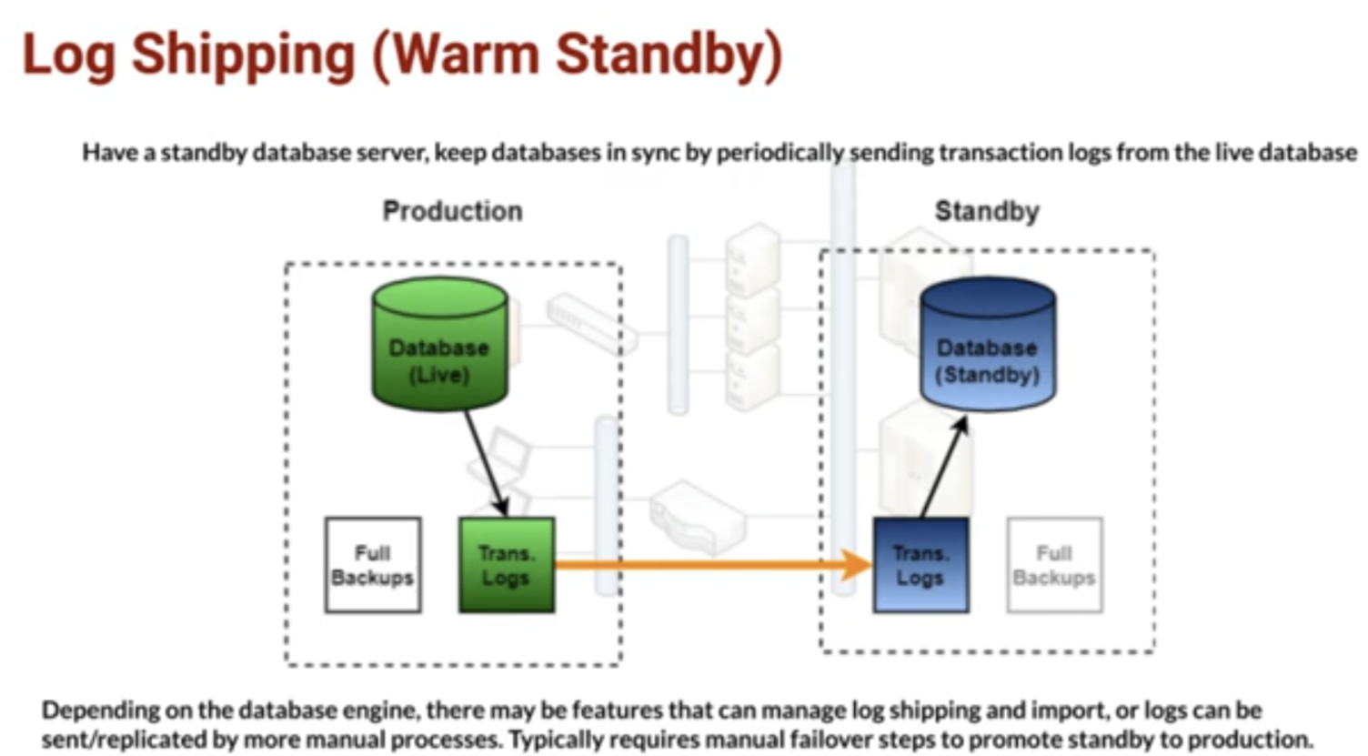

Slide 27
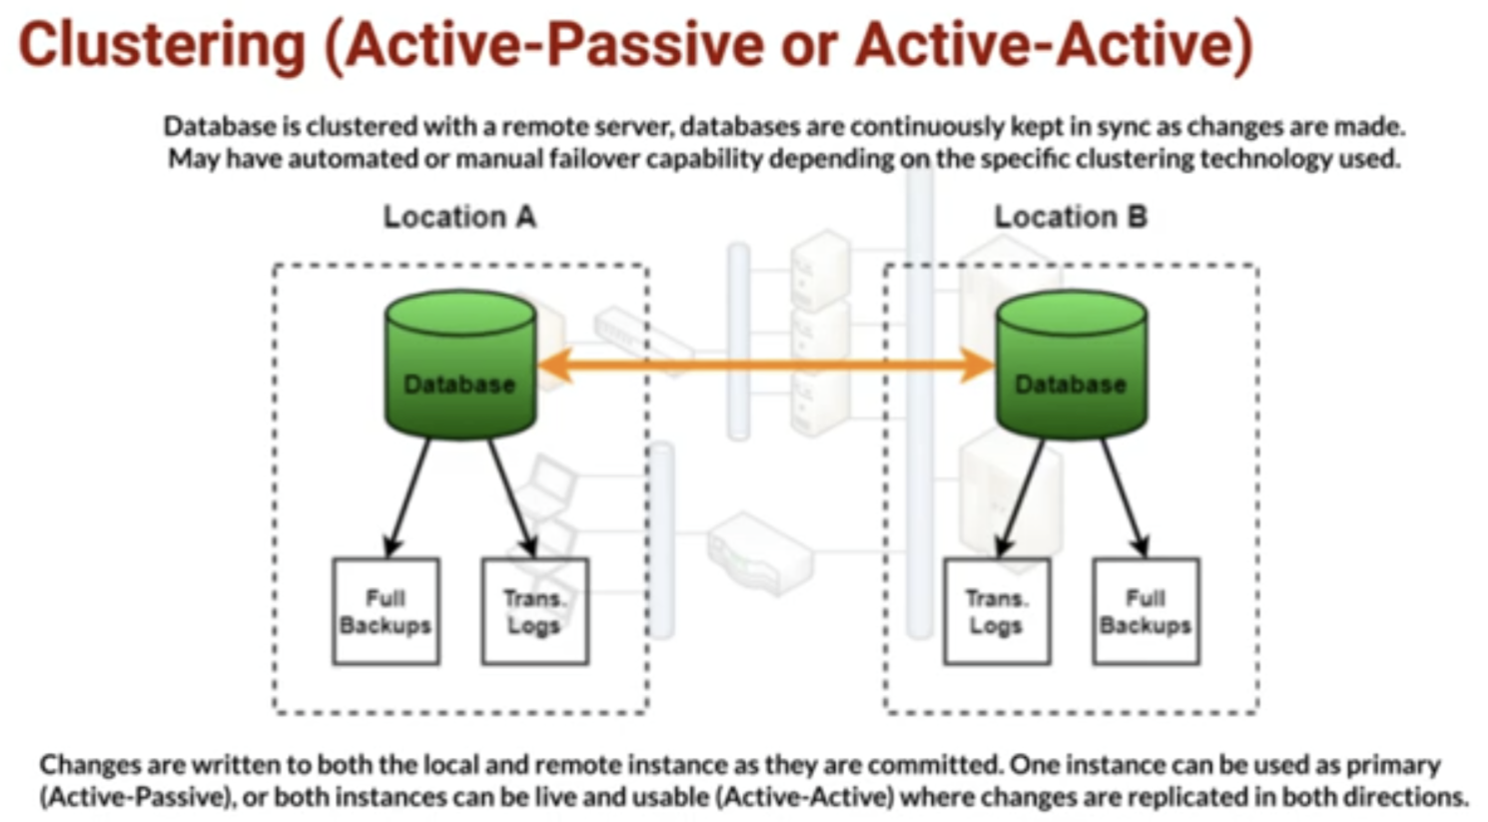

Slide 28
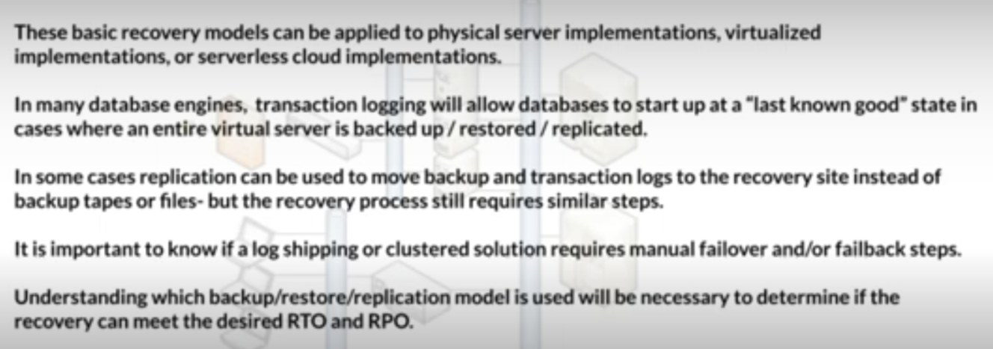
https://www.bing.com/videos/riverview/relatedvideo?q=data+backup+and+recovery+strategies&mid=102AC08A9284B1474A9C102AC08A9284B1474A9C&mcid=DAF81354FC57451FB1DF3F6A24C9F8B5&FORM=VIRE&adlt=strict&toWww=1&redig=9F4943D125504E90B09096B6E2DAA278

Slide 29
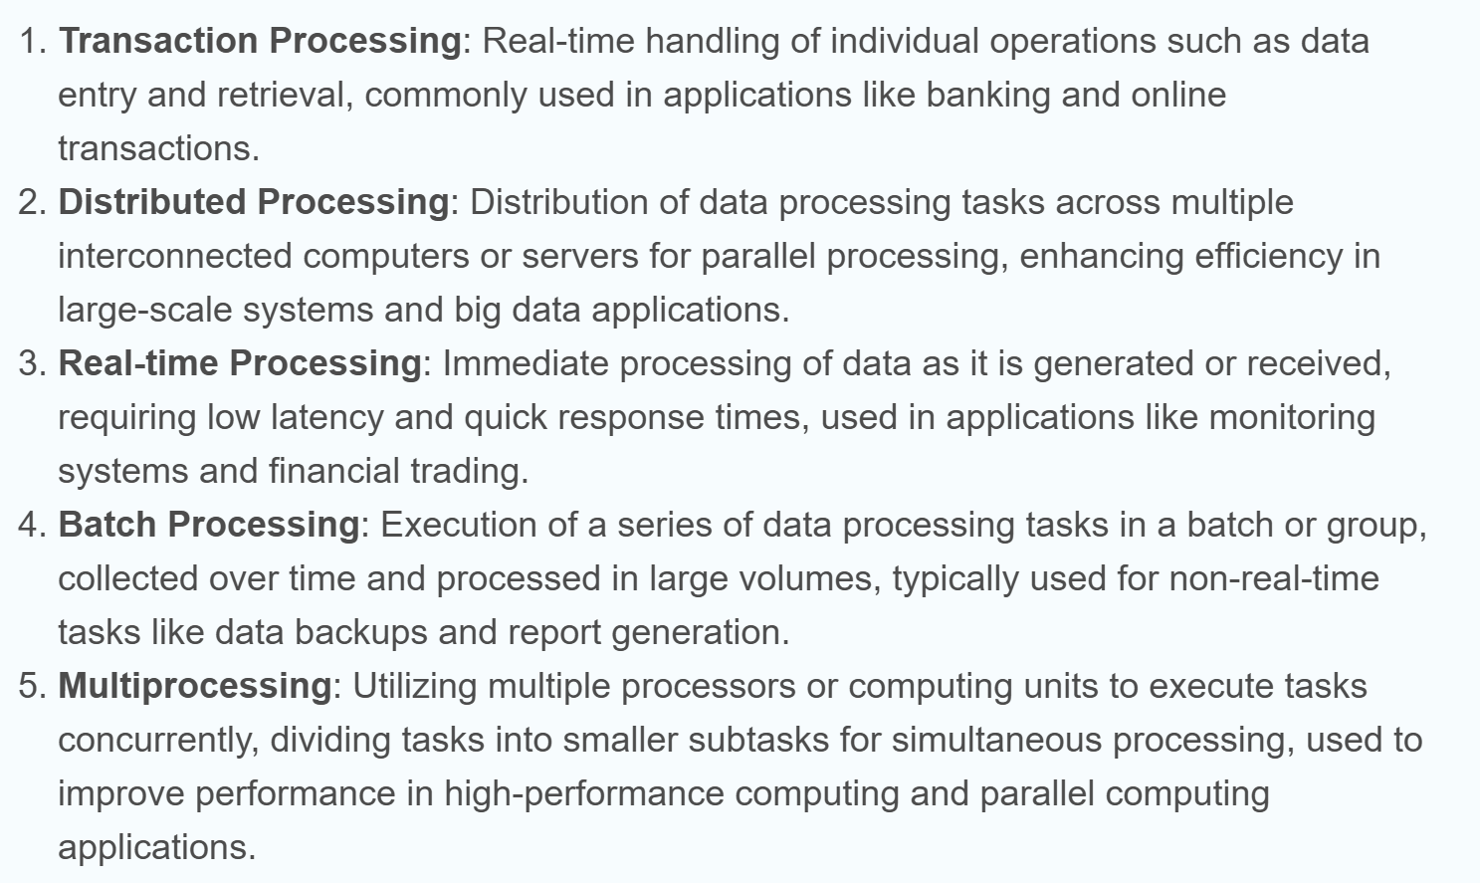
5 types of data processing
https://www.integrate.io/blog/the-5-types-of-data-processing/

Slide 30
Project Milestone :
the interactive web site by management - the one on dash or shiny
the working apis for
registration of account (with optional api requesting for html page input, similar to workshop on name/age)
metre reading (similar to queue taking with optinal api requesting user input to simulate single metre reading since we do not have the physical device)
user query on electricity usage (you can assume what query you would like)
api to stop server from metre readings to activate batch jobs.
the saving of all requests to logs
a good data structure to support the apis
the daily job required to
prepare fresh meter readings on the following day,
cleaning up unwanted data
data preparation aiming to form the denormalised data (like the one you prepared in your individual project)

Slide 31
Coming next ….
the ability to let the server restore back the state before shutdown.
the monthly job for data preparation aiming to form the denormalised data (like the one you preapred in your individual project)
demo test cases for project presentation
project final delivery and presentation (within 12 mins per group, 2 min per student)

Slide 32
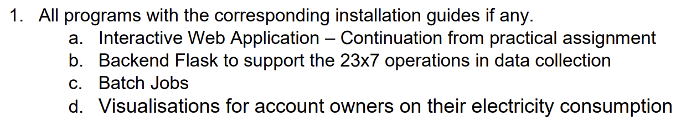
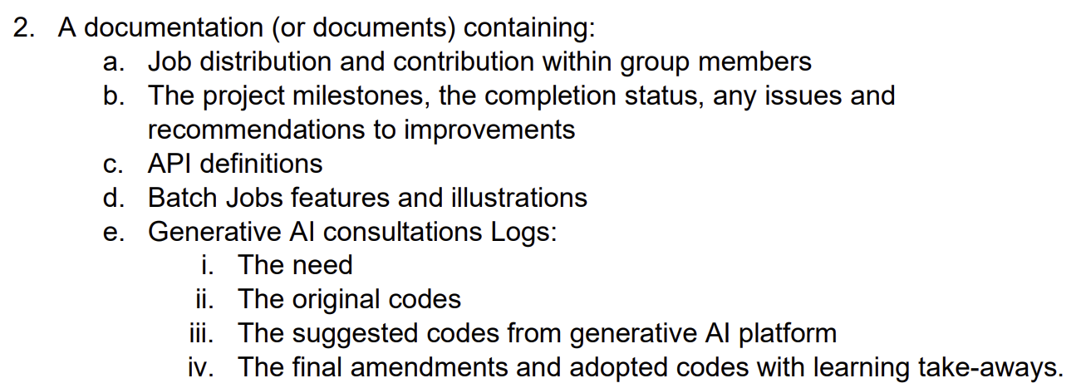
What to submit?

Slide 33
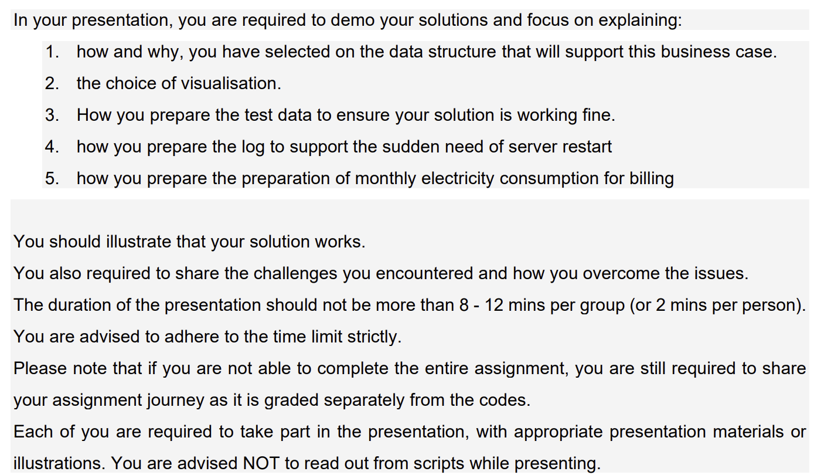
Presentation

Slide 34
Presentation Suggestion
Multiprocessing may not work in some of your computer
Show case on Management Interactive Dashboard
Objectives
Why the design
APIs
Purpose and syntax
Demo the use
Backend Implementations
Data structures used
Algorithms used for storing, retrieving, updating
Justify the choice.
Batch Jobs
How the batch jobs support the following day operations.
How the batch jobs prepare for the final management requirements.
Any gap(s) of the new system and the old reporting requirements?
Any possibility of making use of parallel or distribute processing, justify.
Optional demo
System Recovery
The strategy
Demo and/or explanation
Generative Platform & learning reflections
Experience sharing
Can pre-record some of the demos

Slide 35
Peer- appraisal
MUST do. 5% to your participation
Need to be done by next Tuesday

